Slide 1
Where to be to be Happy
What are the most important factors for a country to feel happy

Slide 2
Data
Happiness Report is published by http://worldhappiness.report
Data is published in xlsx, xls files, no APIs easily available.
That gave us opportunity to learn how to import Excel files into python
Skip rows while importing, identify which sheets to import.
Import multiple xls,xlsx files and combine them into single dataframe
Dataframe manipulation
Many learning opportunities for cleaning up column names, removing unnecessary columns, using select column ranges to remove columns
Concatenating dataframes
Merging dataframes to create a unified dataframe to be used for creating visualizations
Data Export

Slide 3
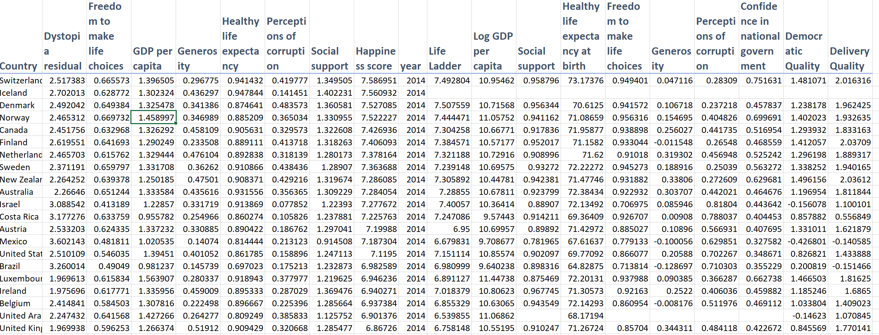
Data

Slide 4
Modularization
Separate Data Cleaning from Data visualization
One notebook to perform the data import, cleaning and then export cleaned data
Use the cleaned data export in another notebook to perform data visualization
This allows to keep the notebooks to manageable sizes
If something breaks, it is easier to troubleshoot by dividing and conquering the problem area
Allow different project members work simultaneously on different aspects of the project

Slide 5
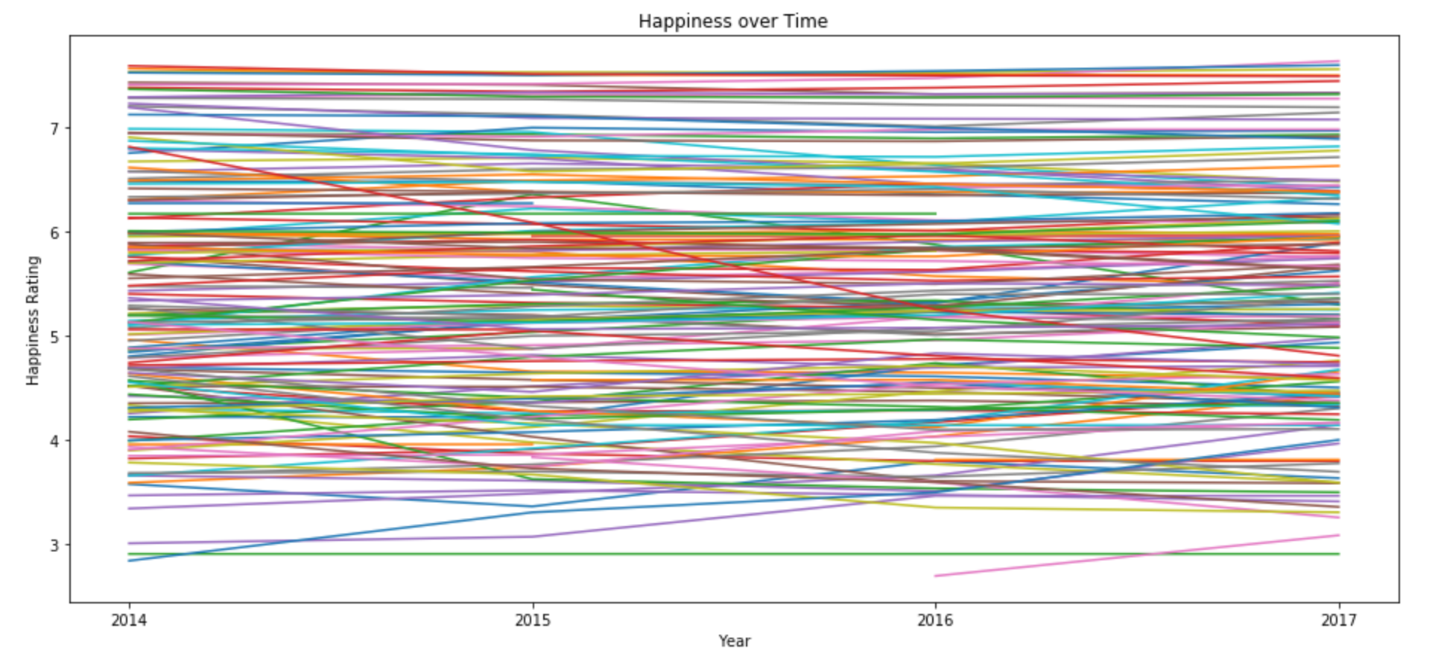
Visualizations

Slide 6
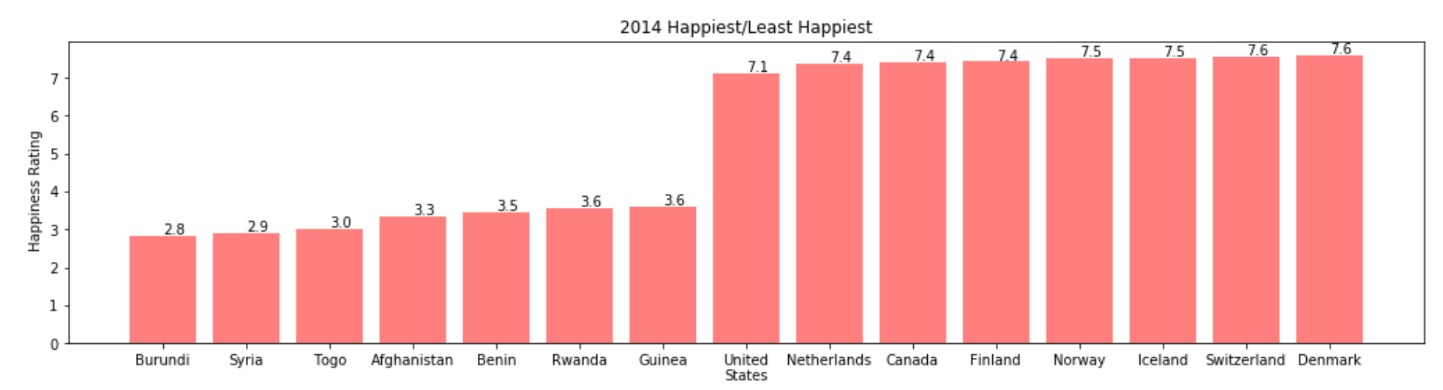
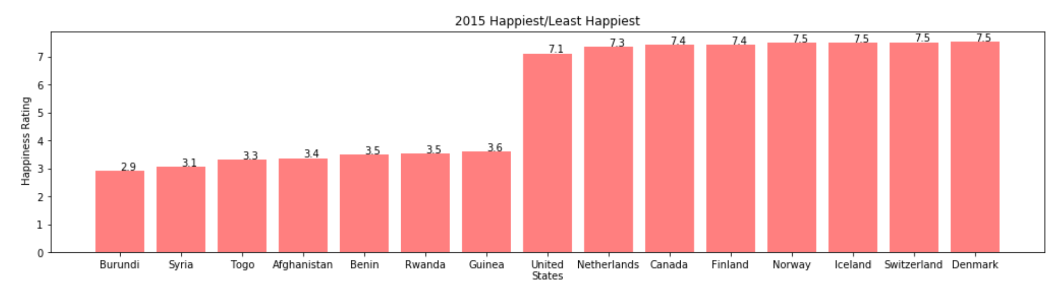
Visualizations
Which are the top/least happiest countries in the world

Slide 7
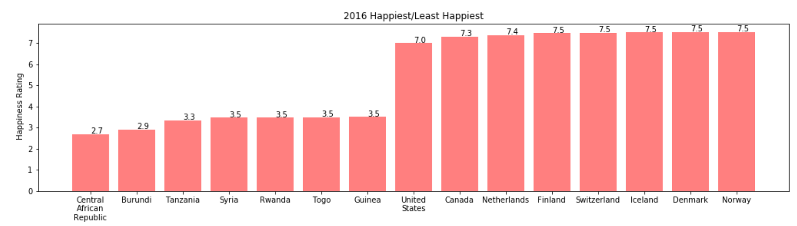
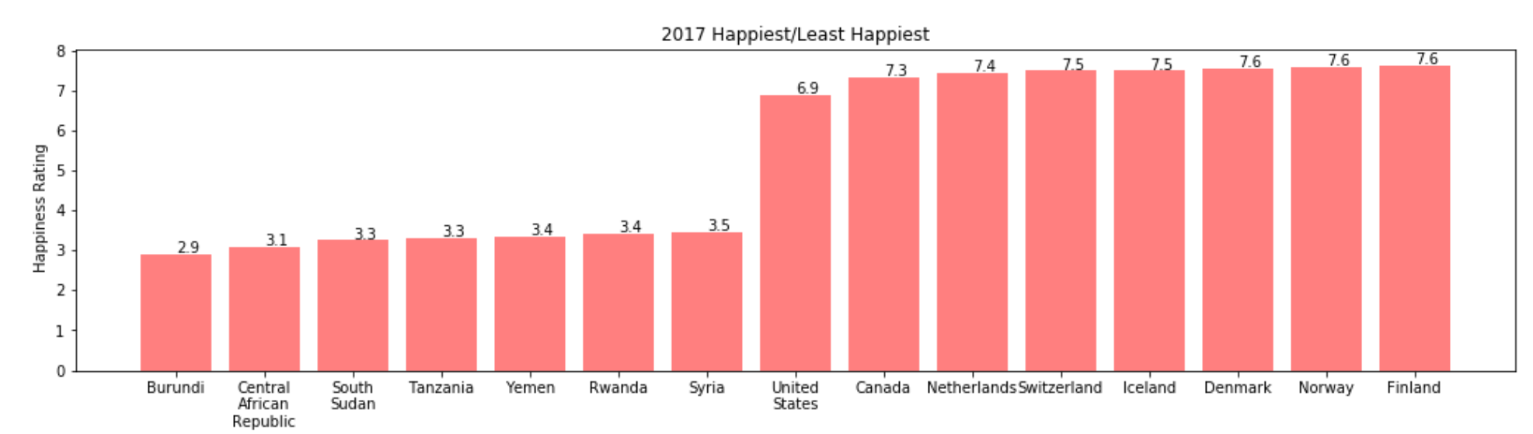
Visualizations
Which are the top/least happiest countries in the world

Slide 8
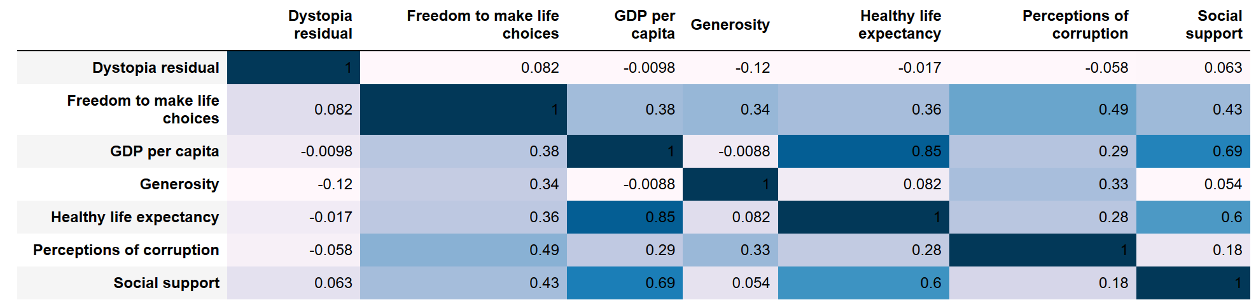
Visualizations
What are the factors that make countries happy
Factors available for analysis :
Dystopia residual
GDP per capita
Healthy life expectancy
Social support
Freedom to make life choices
Generosity
Perceptions of corruption

Slide 9
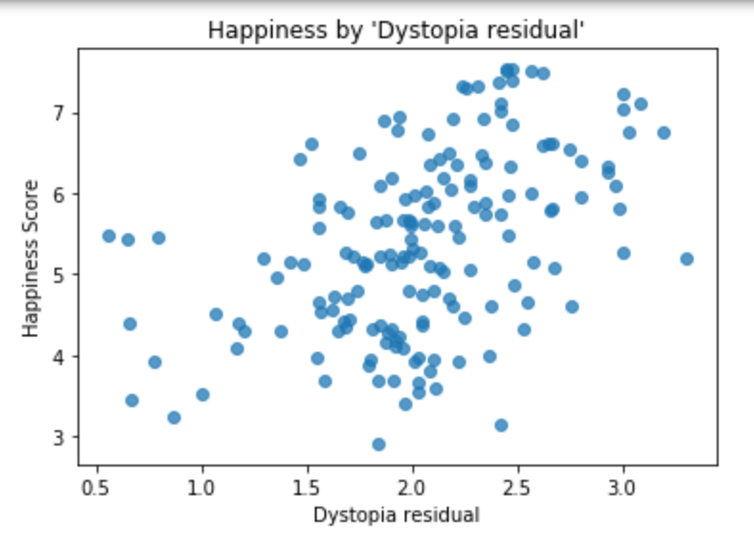
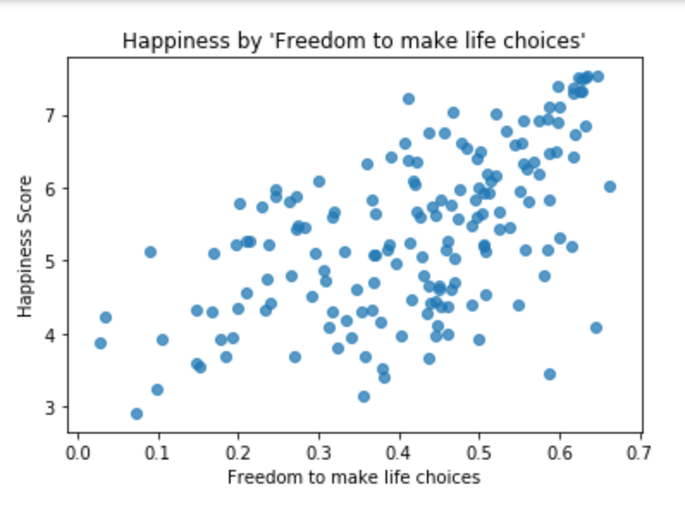
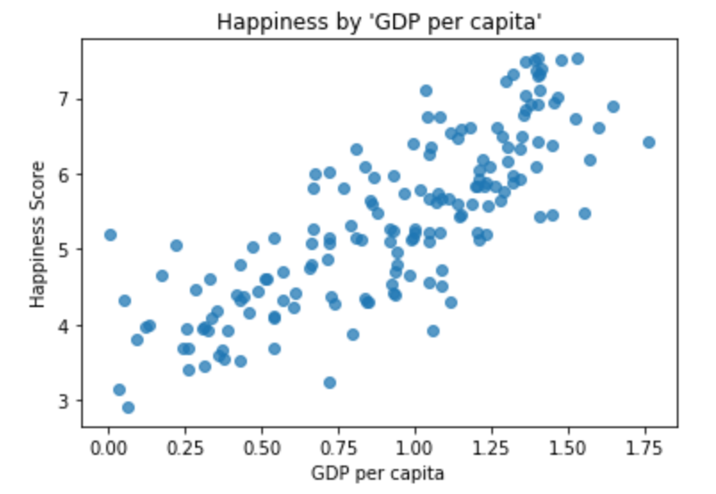
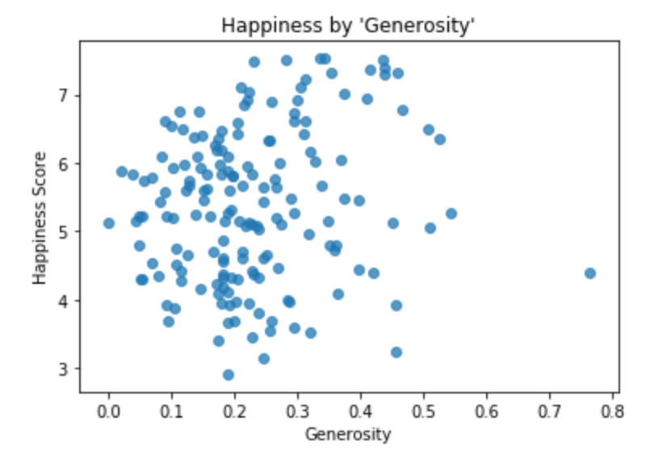
Happiness Factors

Slide 10
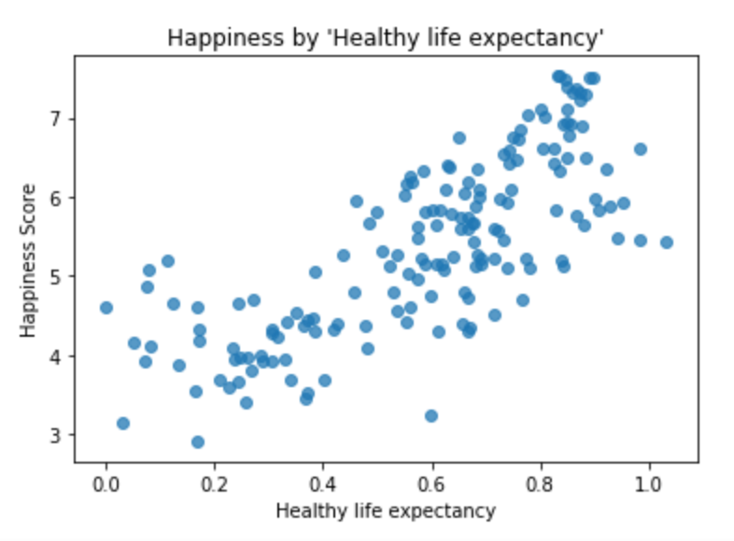
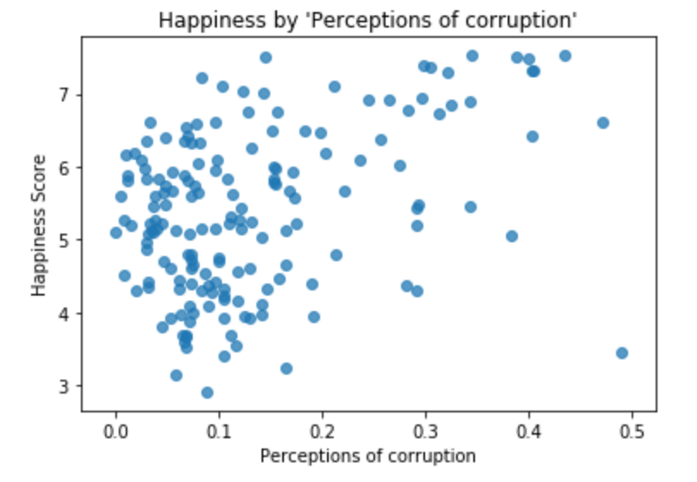
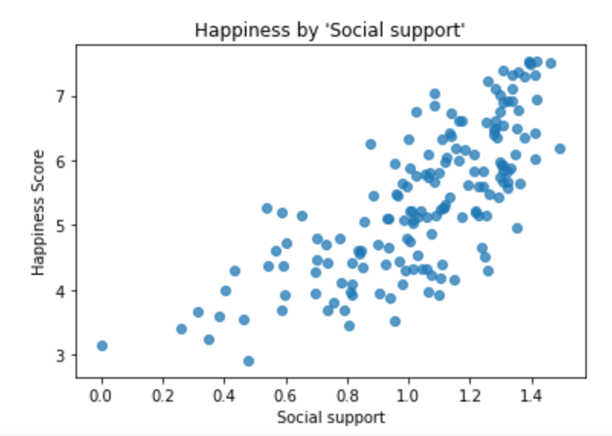
Happiness Factors

